Slide 1
RIP
Routing information protocol

Slide 2
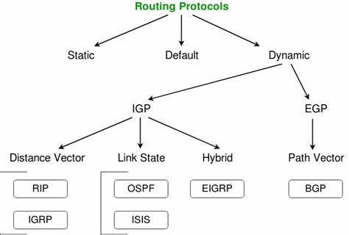
Type of routing protocols

Slide 3
Distance vector - RIP
The distance-vector protocols in use today find the best path to a remote network by judging distance.
In RIP routing, each instance where a packet goes through a router is called a hop , and the route with the least number of hops to the network will be chosen as the best one.
The vector indicates the direction to the remote network.
RIP is a distance-vector routing protocol and periodically sends out the entire routing table to directly connected neighbours.
RIPv1 – classful addressing (older version)
RIPv2 – classless addressing
Notes:
In distance vector routing, the cost is normally hop counts (how many networks are passed before reaching the destination). So the cost between any two neighbors is set to 1.

Slide 4
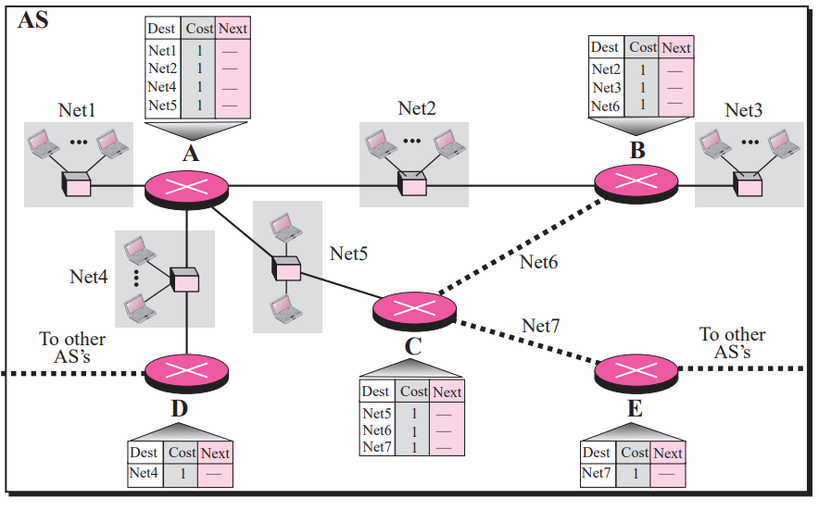
Notes:
Reference book : TCP_IP_Protocol_Suite_4th_ed._B._Forouzan
igure 11.5 shows the initial routing table for an AS. Note that the figure does not mean that all routing tables have been created at the same time; each router creates its own routing table when it is booted.
The router updates itself whenever it receives a record from a neighbor. After each update, the route sends a record for each entry in the routing table to its neighbours to let them also update themselves.

Slide 5
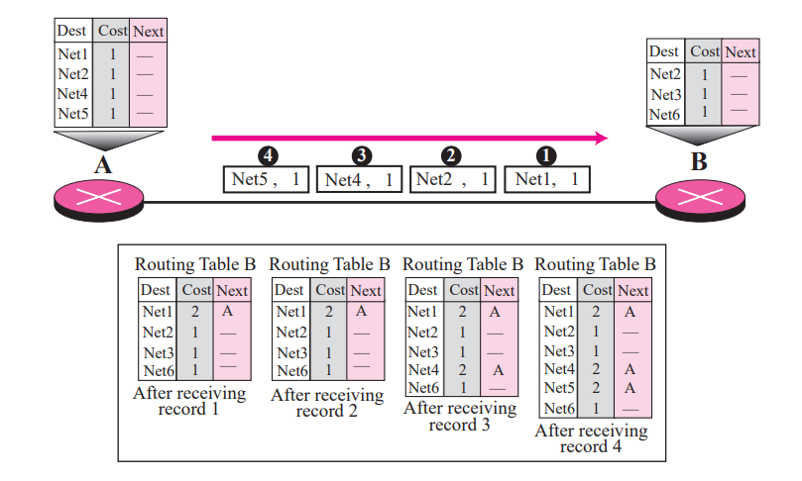
Notes:
a.When router B receives record 1, it searches its routing table for the route to net1, and since it is not found there, it adds one hop to the cost (distance between B and A) and adds it to the table with the next hop to be A.
b. When router B receives record 2, it searches its routing table and finds the destination net2 there. However, since the announced cost plus 1 is larger than the cost in the table, the record is discarded.
c. When router B receives record 3, it searches its router, and since Net4 is not found, it is added to the table. d. When router B receives record 4, it searches its router, and since Net5 is not found, it is added to the table. Now router B has more information, but it is not complete. Router B does not even know that net7 exists. More updating is required

Slide 6
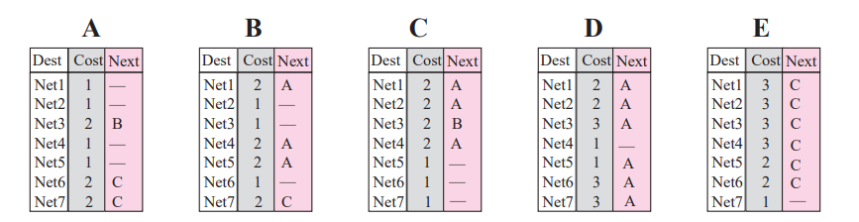

Slide 7
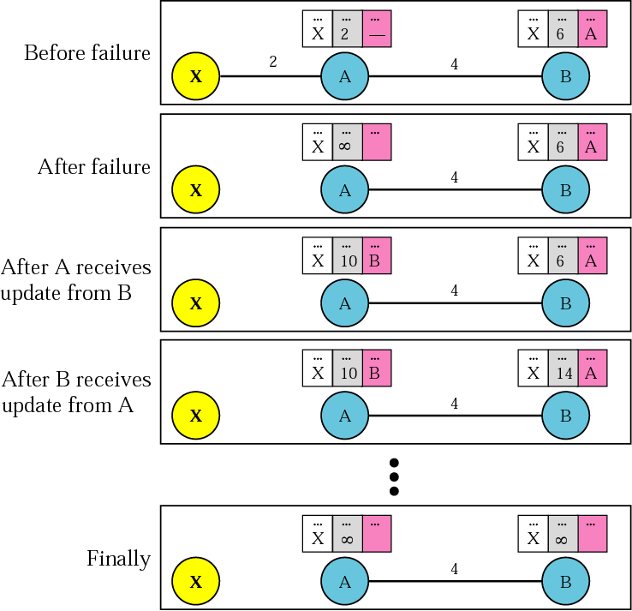
Two-node instability
Notes:
problem with distance vector routing is that any decrease in cost (good news) propagates quickly, but any increase in cost (bad news) propagates slowly. For a routing protocol to work properly, if a link is broken (cost becomes infinity), every other router should be aware of it immediately, but in distance vector routing, this takes some time. The problem is referred to as count to infinity. It takes several updates before the cost for a broken link is recorded as infinity by all routers

Slide 8
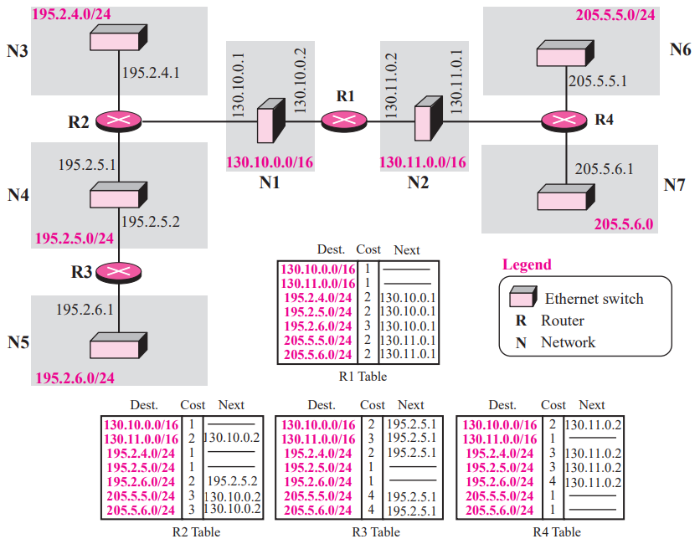

Slide 9
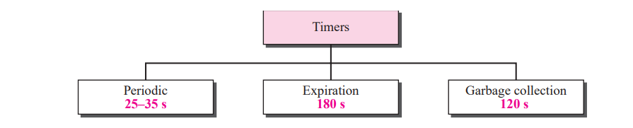
Notes:
Periodic Timer The periodic timer controls the advertising of regular update messages. Although the protocol specifies that this timer must be set to 30 s, the working model uses a random number between 25 and 35 s. This is to prevent any possible synchronization and therefore overload on an internet if routers update simultaneously. Each router has one periodic timer that is randomly set to a number between 25 and 35. It counts down; when zero is reached, the update message is sent, and the timer is randomly set once again.
Expiration Timer The expiration timer governs the validity of a route. When a router receives update information for a route, the expiration timer is set to 180 s for that particular route. Every time a new update for the route is received, the timer is reset. In normal situations this occurs every 30 s. However, if there is a problem on an internet and no update is received within the allotted 180 s, the route is considered expired and the hop count of the route is set to 16, which means the destination is unreachable. Every route has its own expiration timer.
Garbage Collection Timer When the information about a route becomes invalid, the router does not immediately purge that route from its table. Instead, it continues to advertise the route with a metric value of 16. At the same time, a timer called the garbage collection timer is set to 120 s for that route. When the count reaches zero, the route is purged from the table. This timer allows neighbors to become aware of the invalidity of a route prior to purging

Slide 10
RIP configuration
Router1# router rip
Router1#network 174.78.90.0 255.255.255.0

